Slide 1
Lecture 4 String in Java
Department of Computer Science
Hofstra University

Slide 2
Lecture Goals
Describe how Strings are represented in Java Platform
Perform basic operations with Strings in Java
Work with the String’s built-in methods to manipulate Strings
Write regular expressions to match patterns and split strings

Slide 3


Motivation Example
There is hereby imposed on the taxable income of every individual (other than a surviving spouse as defined in section 2(a) or the head of a household as defined in section 2(b)) who is not a married individual (as defined in section 7703) a tax determined in accordance with the following table:
Hard to read
26 U.S. Code § 1 – Tax imposed
https://www.law.cornell.edu/uscode/text/26/1
How do we quantify the difference?
If you are single, never lost your spouse, and not the head of a household, you pay taxes according to the following table:
Easy to read
Use flesch score to measure of text readability
https://en.wikipedia.org/wiki/Flesch%E2%80%93Kincaid_readability_tests

Slide 4
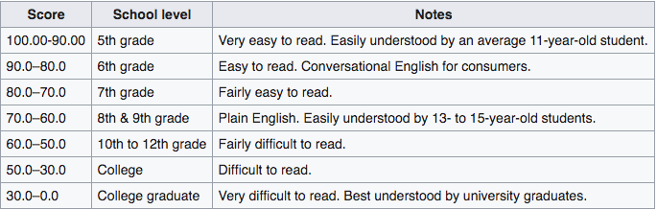
Measure the Text Readability by Flesch Score
number of words per sentence
number of syllables per word
High score: Few words/sentence and few syllables/word
Document is represented as a big long string. Requires the ability to manipulate Strings!
Low score: Many words/sentence and many syllables/word
longer word makes text harder to read than longer sentence
There is hereby imposed on the taxable income of every individual (other than a surviving spouse as defined in section 2(a) or the head of a household as defined in section 2(b)) who is not a married individual (as defined in section 7703) a tax determined in accordance with the following table:
If you are single, never lost your spouse, and not the head of a household, you pay taxes according to the following table:
FleshScore = 12.6
FleshScore = 65.8

Slide 5
String Basics
String text1 = new String("Hello World!");
String text2 = text1;
String text3 = text1.concat("It’s a great day.");
String text4 = text1 + "It’s a great day.";
String text5 = "Hello World!”;
String text6 = "Hello World!”;
String text7 = new String("Hello World!");
text7.equals(text1);
text7 == text1;
String is an object
Strings are immutable
String append
Interned Strings: One object
// true
Compare string
‘h’
‘e’
‘l’
‘l’
‘o’
‘ ’
‘W’
‘o’
‘r’
‘l’
‘d’
‘!’
// false
Java Heap
text1
no way to change
"Hello World!"
doesn’t change
text2
Two references to the same object
In heap, Strings are basically represented as arrays of chars
"Hello World! It's a great day."
text3
makes another object
text4
"Hello World! It's a great day."
+ operator also does append
text5
"Hello World!"
text6
text7
"Hello World!"

Slide 6
String Class’s Built-in Methods
Strings can do lots of things:
https://docs.oracle.com/javase/10/docs/api/java/lang/String.html
Let’s look at some methods in the context of our problems:
length, charAt, toCharArray, indexOf, split
For example, we need to look at words, character by character, to calculate the number of syllables.
does the letter appear anywhere in the word?
public static boolean hasLetter(String word, char letter)
{
for (int i = 0; i < word.length(); i++) {
if (word.charAt(i) == letter) {
return true;
}
}
return false;
}
Loop over the indexes of character array in the string
length() returns the number of characters in the String
charAt(i) cannot be used to change the String
Get each letter and compare it to the char in question
If no letters match, return false
charAt(i) returns the char at index i in the String

Slide 7
Count the number of syllables (Contd.)
public static boolean hasLetter(String word, char letter)
{
for (char c: word.toCharArray()) {
if (c == letter) {
return true;
}
}
return false;
}
Same method, using a for-each loop
toCharArray() returns the chars in a String, as a char[]
Change this method so that it returns the index where it first finds letter (or -1 if it doesn't find it)?
int
public static boolean hasLetter(String word, char letter)
{
for (int i = 0; i < word.length(); i++) {
if (word.charAt(i) == letter) {
return true;
}
}
return false;
}
built-in String method indexOf(String str) does exactly this, but with a String to match.
0
i
String text = "Can you hear me? Hello, hello?
int index = text.indexOf("he"); // index is 8
index = text.indexOf("He"); // index is 17
index = text.indexOf("Help"); // index is -1
-1
For dealing with case, check out String methods: equalsIgnoreCase, toLowerCase, toUpperCase

Slide 8
Manipulate String with For-each Loop
public static string replaceLetter(String word, char gone, char new1)
{
char[] cArray = word.toCharArray();
for (char c: cArray) {
if (c == gone) {
c = new1;
}
}
return word;
return new String(cArray);
}
Does this method successfully return a modified word?
Attempt #1: NO
Attempt #2: NO
Let’s trace the code with memory model diagram
// replaceLetter("a happy", 'a', 'i') -> "i hippy"??
replaceLetter
Java Heap
toCharArray() returns a copy of word's array of chars
word
"a happy"
gone
‘a’
new
‘i’
cArray
‘a’
‘ ’
‘h’
‘a’
‘p’
‘p ’
‘y’
c
‘a’
‘i’

Slide 9
Manipulate String with For-each Loop (Contd.)
public static string replaceLetter(String word, char goneIn, char newIn)
{
char[] cArray = word.toCharArray();
char[] cArrayMod = new char[cArray.length];
int i = 0;
for (char c: cArray) {
if (c == goneIn)
cArrayMod[i] = newIn;
else
cArrayMod[i] = c;
i++;
}
return new String(cArrayMod);
}
Does this method successfully return a modified word?
Attempt #1: NO
Attempt #2: NO
Attempt #3: YES
// replaceLetter("a happy", 'a', 'i') -> "i hippy"??
replaceLetter
Java Heap
word
"a happy"
doesn’t change
goneIn
‘a’
newIn
‘i’
cArray
‘a’
‘ ’
‘h’
‘a’
‘p’
‘p ’
‘y’
c
i
0
1
2
3
4
5
‘a’
6
‘ ’
‘h’
‘a’
‘p’
‘p’
‘y’
cArrayMod
‘i’
‘ ’
‘h’
‘i’
‘p’
‘p’
‘y’

Slide 10
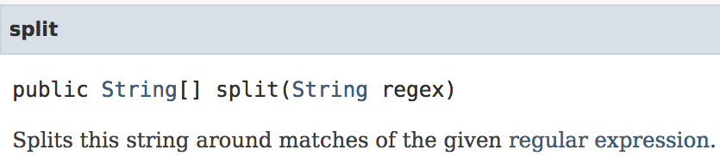
Count the number of words
Use String method split(String pattern) to split apart the String.
String text = "Can you hear me? Hello, hello?";
String[] words = text.split(" ");
words
“Can”
“you”
“hear”
“me?”
“Hello,”
“hello?”
what if we add an extra space here
String text = “Can you hear me? Hello, hello?";
String[] words = text.split(" ");
words
“Can”
“you”
“hear”
“me?”
“”
“Hello,”
“hello?”
it doesn’t take a string

Slide 11
Introduction to Regular Expressions (Regex)
Regular expression’s basic units are characters, and it represents the pattern we are trying to match.
String text = "Hello hello?";
String[] words = text.split(" ");
“Hello”
“”
“hello?”
This single space is a regular expression. It matches single spaces
3 ways to combine
Repetition
Concatenation
Alternation
Repetition: + means 1 or more
String text = "Hello hello?";
String[] words = text.split(" +");
“Hello”
“hello?”
Matches 1 or more spaces in a row

Slide 12
Create More Complicated Regex
public class Document {
private String text; // The text of the whole document
protected List<String> getTokens(String pattern)
}
returns a List of "tokens"
regex defining the "tokens"
Assume you have a Document object, d, whose text is "Hello hello?”
d.getTokens(" +");
-> [" "]
Repetition
Matches 1 or more spaces
Assume you have a Document object, d, whose text is "Splitting a string, it's as easy as 1 2 33! Right?"
Concatenation
d.getTokens("it");
-> ["it", "it"]
Two regular expressions side by side. Matches when both appear one after the other
Assume you have a Document object, d, whose text is "Splitting a string, it's as easy as 1 2 33! Right?"
Concatenation and Repetition
d.getTokens("it+");
-> ["itt", "it"]
+ means "one or more"

Slide 13
Create More Complicated Regex (Contd.)
public class Document {
private String text; // The text of the whole document
protected List<String> getTokens(String pattern)
}
Assume you have a Document object, d, whose text is "Splitting a string, it's as easy as 1 2 33! Right?"
d.getTokens("i(t+)");
-> ["itt", "it"]
Use parens to group r.e.'s if you are not sure of grouping
Concatenation and Repetition
Assume you have a Document object, d, whose text is "Splitting a string, it's as easy as 1 2 33! Right?"
d.getTokens("it*");
-> ["itt", "i", "i", "it", "i"]
* means "zero or more"
Assume you have a Document object, d, whose text is "Splitting a string, it's as easy as 1 2 33! Right?"
d.getTokens("it|st");
-> ["it", "st", "it"]
Alternation
| means OR

Slide 14
Create More Complicated Regex (Contd.)
public class Document {
private String text; // The text of the whole document
protected List<String> getTokens(String pattern)
}
Assume you have a Document object, d, whose text is "Splitting a string, it's as easy as 1 2 33! Right?"
d.getTokens("[123]");
-> ["1", "2" , "3", "3"]
Character classes
[ ] mean match "anything in the set"
d.getTokens("[1-3]");
-> ["1", "2" , "3", "3"]
- indicates a range (any character between 1 and 3)
Assume you have a Document object, d, whose text is "Splitting a string, it's as easy as 1 2 33! Right?"
d.getTokens("[a-f]");
-> ["a", "a", "e", "a", "a"]
- indicates a range (any character between a and f)
Assume you have a Document object, d, whose text is "Splitting a string, it's as easy as 1 2 33! Right?"
Negation
d.getTokens("[^a-z123 ]");
-> ["S", ",", "’", "!", "R", "?"]
^ indicates NOT any characters in this set
^{Excluding a character}

Slide 15
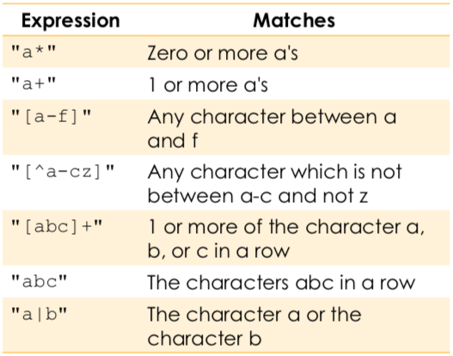
Some Practices
public class Document {
private String text; // The text of the whole document
protected List<String> getTokens(String pattern)
}
Assume you have a Document object, d, whose text is "Splitting a string, it's as easy as 1 2 33! Right?"
Which of the following regular expressions can you insert in the blank so that it will give the output shown? Select all that apply.
d.getTokens("__________");
-> ["1", "2" , "33"]
A. "[1233]"
✖
-> ["1", "2", "3", "3"]
Option C is FAR more versatile. It captures ANY non-negative integer (not just 1, 2, and 33).
same as [123]
B. "[1,2,33]"
✖
-> [",", "1", "2", "3", "3"]
simply add comma to the group of letters that we're looking for.
C. "[0-9]+"
✔
-> ["1", "2" , "33"]
✖
["","","","","","","","","","","","","","","","" ,"","","","","","","","","","","","","","","","" ,"","","","","1","","2","","33","","","","",""," ","","", ""]
D. "[1-3]*"
->
return empty string if the char is not in the group
E. "1|2|33"
✔
-> ["1", "2" , "33"]
Notes:
·

Slide 16
Use Regex to Calculate Flesch Score
public class Document {
private String text; // The text of the whole document
protected List<String> getTokens(String pattern)
public abstract int getNumWords();
public abstract int getNumSentences();
given helper method
Need a regex that matches "any word"
public class BasicDocument extends Document {
@Override
public int getNumWords() {
List<String> tokens = getTokens("___________");
return tokens.size();
}
@Override
public int getNumSentences()
{
List<String> tokens = getTokens("_________");
return tokens.size();
}
"Any contiguous sequence of alphabetic characters"
What constitutes a word?
What constitutes a sentence?
"A contiguous sequence of characters that does NOT include end of sentence punctuation."
"A sequence of any characters ending with end of sentence punctuation (. ! ?)"
http://www.tutorialspoint.com/java/java_regular_expressions.htm

Slide 17
Regex Exercises
^re\w+ed$
Matches strings that start with "re" and end with "ed" (like "received" or "renewed")
^re*ed$
Matches strings that start with "re", with e repeated 0 or more times, and end with "ed" (like "reed" or "reeed” or "reeeeeeeed")
^(re)*ed$
ed, reed, rereed, rerererereed
^[re]*ed$
ed, eed, red, rrrred, eerreerred, rerereed
^[re]+ed$
eed, red, rrrred, eerreerred, rerereed, but NOT ed
^re{2}ed$
Matches reeed
^(re){2}ed$
Matches rereed
re\wed
\w Matches any single word character (letter, digit, or underscore)
Matches "re" followed by exactly one word character, followed by "ed“ (like rexed, re1ed, re_ed, reAed)
re.ed
. Matches any single character (except newline)
Matches “re” followed by exactly one single character, followed by “ed“ (like rexed, re-ed, re ed (including a space), re3ed, re.ed (matching a literal period)(

Slide 18
[re]*, [re]+
This regular expression will match: Any sequence of 'r' and 'e' characters, including an empty string
The characters 'r' and 'e' can appear in any order and any number of times
Examples of Matching Strings
"" (empty string)
"r"
"e"
"re"
"er"
"ree"
"rre"
"eerr“
"rererere"
Examples of Non-Matching Strings
"a" (contains a character other than 'r' or 'e')
"read" (contains characters other than 'r' or 'e')
"RED" (case-sensitive, uppercase letters don't match)
[re]+ will match any sequence of 'r' and 'e' characters, will not match "" (empty string)

Slide 19
[^re]
The ^ inside the square brackets [] negates the character class, meaning it matches any character except those listed.
Components of the Regular Expression
[^re] - A negated character class that matches any single character that is NOT 'r' or 'e'
+ - Quantifier that matches one or more occurrences of the preceding pattern
Matching Pattern
This regular expression will match:
One or more characters that are neither 'r' nor 'e'
Any sequence of characters as long as it doesn't contain 'r' or 'e'
Examples of Matching Strings
"a"
"abc"
"123"
"xyz"
"!@#"
"The quick brown fox"
Examples of Non-Matching Strings
"" (empty string, doesn't match because + requires at least one character)
"r" (contains 'r')
"e" (contains 'e')
"read" (contains both 'r' and 'e')

